Slide 1
COMPILER CONSTRUCTION
Module III
LR PARSERS
Mr. Roshan Lal
ASET(CSE)

Slide 2
Module III:
Different types of LR Parsers
Simple LR(0) collection of items
SLR parsing table
SLR parsing
LR(1) collection of items
CLR parsing table
CLR parsing
LALR parsing table
LALR parsing

Slide 3
Recommended Reading​
Textbooks: ​
Alfred V. Aho, Monica S. Lam, Ravi Sethi, Jeffrey D. Ullman, “Compilers: Principles Techniques and Tool”, Second Edition, Pearson Publication, 2007.​
​
A.A Putambekar, “Compiler Construction”, Technical Publications, 2009. ​
​
Reference Book: ​
Des Watson, A Practical Approach to Compiler Construction, First Edition, Springer, 2017​

Slide 4
OBJECTIVES
After completing this section, you will be able to
1.1 Analyze & implement SLR parsing techniques.
1.2 Analyze & implement CLR parsing techniques.
1.3 Analyze & implement LALR parsing techniques.

Slide 5
Module Assessment​
Quiz (Conceptual and Numerical Based)
​
Assignment

Slide 6
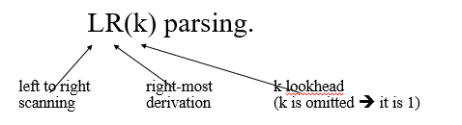
LR Parsers
The most powerful shift-reduce parsing (yet efficient) is:
LR parsing is attractive because:
LR parsing is most general non-backtracking shift-reduce parsing, yet it is still efficient.
The class of grammars that can be parsed using LR methods is a proper superset of the class of grammars that can be parsed with predictive parsers. LL(1)-Grammars ⊂ LR(1)-Grammars
An LR-parser can detect a syntactic error as soon as it is possible to do so a left-to-right scan of the input.

Slide 7
LR Parsers
Advantages of the LR parser
Recognize the most programming languages.
More general than LL parser
Detect errors during parsing

Slide 8
LR Parsers
Different types of LR-Parsers
SLR – simple LR parser
CLR – Canonical LR parser( Most powerful LR parser)
LALR – Look-head LR parser(Intermediate LR parser )
SLR, LR and LALR work same (they used the same algorithm), only their parsing tables are different.

Slide 9
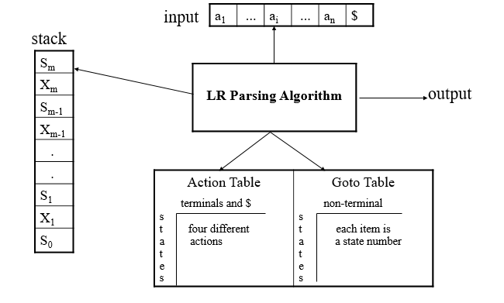
LR Parsing Algorithm

Slide 10

A Configuration of LR Parsing Algorithm
A configuration of a LR parsing is:
S_{m} and a_{i} decides the parser action by consulting the parsing action table. (Initial Stack contains just S_{o} )
A configuration of a LR parsing represents the right sentential form:
X₁ ... X_{m} a_{i} a_{i+1} ... a_{n} $

Slide 11
Actions of a LR-Parser
shift s -- shifts the next input symbol and the state s onto the stack
( S_{o} X₁ S₁ ... X_{m} S_{m}, a_{i} a_{i+1} ... a_{n} $ ) ➔ ( S_{o} X₁ S₁ ... X_{m} S_{m} a_{i} s, a_{i+1} ... a_{n} $ )
reduce A→β (or rn where n is a production number)
pop |β| (=r) items from the stack;
then push A and s where s=goto[s_{m-r} ,A]
( S_{o} X₁ S₁ ... X_{m} S_{m}, a_{i} a_{i+1} ... a_{n} $ ) ➔ ( S_{o} X₁ S₁ ... X_{m-r} S_{m-r} A s, a_{i} ... a_{n} $ )
Output is the reducing production reduce A→β
Accept – Parsing successfully completed
Error -- Parser detected an error (an empty entry in the action table)

Slide 12
Reduce Action
pop |β| (=r) items from the stack; let us assume that β = Y₁Y₂...Y_{r}
then push A and s where s=goto[s_{m-r},A]
( S_{o} X₁ S₁ ... X_{m-r} S_{m-r} Y₁ S_{m-r+1} ...Y_{r} S_{m}, a_{i} a_{i+1} ... a_{n} $ )
➔ ( S_{o} X₁ S₁ ... X_{m-r} S_{m-r} A s, a_{i} ... a_{n} $ )
In fact, Y₁Y₂...Y_{r} is a handle.
X₁ ... X_{m-r} A a_{i} ... a_{n} $ ⇒ X₁ ... X_{m} Y₁...Y_{r} a_{i} a_{i+1} ... a_{n} $

Slide 13
Constructing SLR Parsing Tables – LR(0) Item
An LR(0) item of a grammar G is a production of G a dot at the some position of the right side.
Ex: A → aBb Possible LR(0) Items: A → .aBb
(four different possibility) A → a.Bb
A → aB.b
A → aBb.
Sets of LR(0) items will be the states of action and goto table of the SLR parser.
A collection of sets of LR(0) items (the canonical LR(0) collection) is the basis for constructing SLR parsers.
Augmented Grammar:
G’ is G with a new production rule S’→S where S’ is the new starting symbol.

Slide 14
The Closure Operation
If I is a set of LR(0) items for a grammar G, then closure(I) is the set of LR(0) items constructed from I by the two rules:
Initially, every LR(0) item in I is added to closure(I).
If A → α.Bβ is in closure(I) and B→γ is a production rule of G; then B→.γ will be in the closure(I). We will apply this rule until no more new LR(0) items can be added to closure(I).

Slide 15
The Closure Operation-Example
E’ → E closure({E’ → .E}) =
E → E+T { E’ → .E kernel items
E → T E → .E+T
T → T*F E → .T
T → F T → .T*F
F → (E) T → .F
F → id F → .(E)
F → .id }

Slide 16
Computation of Closure
function closure ( I )
begin
J := I;
repeat
for each item A → α.Bβ in J and each production
B→γ of G such that B→.γ is not in J do
add B→.γ to J
until no more items can be added to J
end

Slide 17
GOTO Operation
If I is a set of LR(0) items and X is a grammar symbol (terminal or non-terminal), then goto(I,X) is defined as follows:
If A → α.Xβ in I then every item in closure({A → αX.β}) will be in goto(I,X).
If I is the set of items that are valid for some viable prefix γ, then goto(I,X) is the set of items that are valid for the viable prefix γX.
Example: I ={ E’ → .E, E → .E+T, E → .T,
T → .T*F, T → .F,
F → .(E), F → .id }
goto(I,E) = { E’ → E., E → E.+T }
goto(I,T) = { E → T., T → T.*F }
goto(I,F) = {T → F. }
goto(I,() = { F → (.E), E → .E+T, E → .T, T → .T*F, T → .F,
F → .(E), F → .id }
goto(I,id) = { F → id. }

Slide 18
Practice Questions
Ques 1: Consider the grammar S-> Aa| bAc| Bc| bBa, A->d, B->d
Compute closure(I) and goto(I)
Ques2: Consider the grammar S-> AS| b , A->SA|a
Compute closure(I) and goto(I)

Slide 19
Construction of The Canonical LR(0) Collection
To create the SLR parsing tables for a grammar G, we will create the canonical LR(0) collection of the grammar G’.
Algorithm:
C is { closure({S’→.S}) }
repeat the followings until no more set of LR(0) items can be added to C.
for each I in C and each grammar symbol X
if goto(I,X) is not empty and not in C
add goto(I,X) to C
goto function is a DFA on the sets in C.

Slide 20
The Canonical LR(0) Collection-Example
I₀: E’ → .E I₁: E’ → E. I₆: E → E+.T I₉: E → E+T.
E → .E+T E → E.+T T → .T*F T → T.*F
E → .T T → .F
T → .T*F I₂: E → T. F → .(E) I₁₀: T → T*F.
T → .F T → T.*F F → .id
F → .(E)
F → .id I₃: T → F. I₇: T → T*.F I₁₁: F → (E).
F → .(E)
I₄: F → (.E) F → .id
E → .E+T
E → .T I₈: F → (E.)
T → .T*F E → E.+T
T → .F
F → .(E)
F → .id
I₅: F → id.

Slide 21
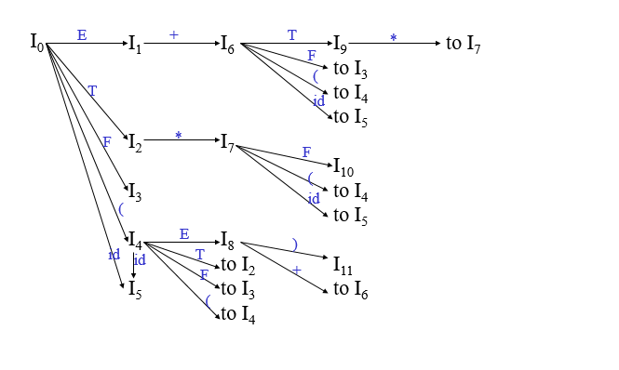
Transition Diagram (DFA) of Goto Function

Slide 22
Constructing SLR Parsing Table (of an augumented grammar G’)
Construct the canonical collection of sets of LR(0) items for G’. C←{I₀,...,I_{n}}
Create the parsing action table as follows
If a is a terminal, A→α.aβ in I_{i} and goto(I_{i},a)=I_{j} then action[i,a] is shift j.
If A→α. is in I_{i} , then action[i,a] is reduce A→α for all a in FOLLOW(A) where A≠S’.
If S’→S. is in I_{i} , then action[i,$] is accept.
If any conflicting actions generated by these rules, the grammar is not SLR(1).
Create the parsing goto table
for all non-terminals A, if goto(I_{i},A)=I_{j} then goto[i,A]=j
All entries not defined by (2) and (3) are errors.
Initial state of the parser contains S’→.S

Slide 23
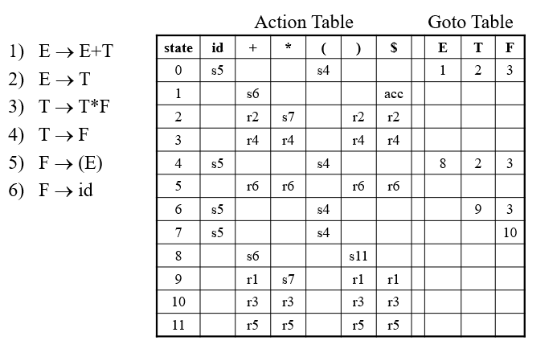
(SLR) Parsing Tables for Expression Grammar

Slide 24
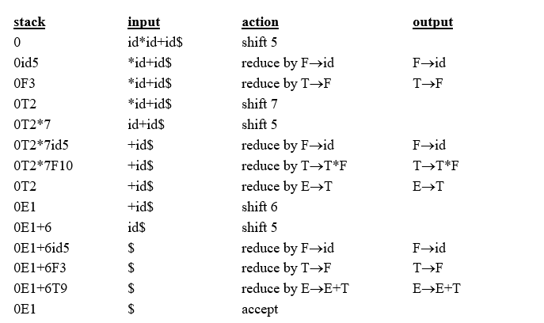
Actions of (S)LR-Parser -- Example

Slide 25
Practice Question
Ques 1: Consider the following grammar
E-> E+ T | T
T-> TF | F
F-> F * | a | b
Construct the SLR parsing table for this grammar.
Ques 2: Construct SLR Parsing table for the grammar
S-> L= R
S-> R
L->*R
L-> id
R-> L

Slide 26
SLR(1) Grammar
An LR parser using SLR(1) parsing tables for a grammar G is called as the SLR(1) parser for G.
If a grammar G has an SLR(1) parsing table, it is called SLR(1) grammar (or SLR grammar in short).
Every SLR grammar is unambiguous, but every unambiguous grammar is not a SLR grammar.

Slide 27
shift/reduce and reduce/reduce conflicts
If a state does not know whether it will make a shift operation or reduction for a terminal, we say that there is a shift/reduce conflict.
If a state does not know whether it will make a reduction operation using the production rule i or j for a terminal, we say that there is a reduce/reduce conflict.
If the SLR parsing table of a grammar G has a conflict, we say that that grammar is not SLR grammar.

Slide 28
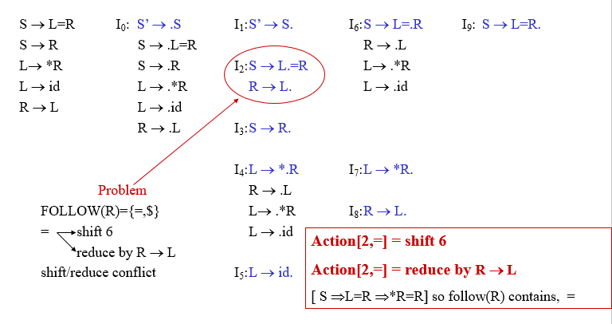
Conflict Example-1

Slide 29
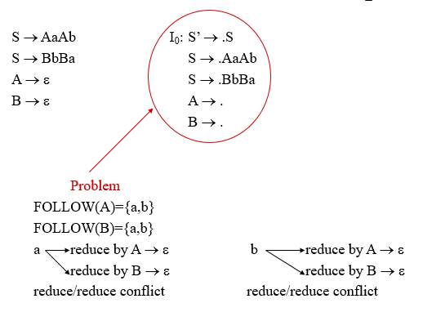
Conflict Example-2

Slide 30
LR(1) Item
To avoid some of invalid reductions, the states need to carry more information.
Extra information is put into a state by including a terminal symbol as a second component in an item.
A LR(1) item is:
A → α.β,a where a is the look-head of the LR(1) item
(a is a terminal or end-marker.)
Such an object is called LR(1) item.
1 refers to the length of the second component
The lookahead has no effect in an item of the form [A → α.β,a], where β is not ∈.
But an item of the form [A → α.,a] calls for a reduction by A → α only if the next input symbol is a.
The set of such a’s will be a subset of FOLLOW(A), but it could be a proper subset.

Slide 31
LR(1) Item(cont.)
When β ( in the LR(1) item A → α.β,a ) is not empty, the look-head does not have any affect.
When β is empty (A → α.,a ), we do the reduction by A→α only if the next input symbol is a (not for any terminal in FOLLOW(A)).
A state will contain A → α.,a₁ where {a₁,...,a_{n}} ⊆ FOLLOW(A)
...
A → α.,a_{n}

Slide 32
Canonical Collection of Sets of LR(1) Items
The construction of the canonical collection of the sets of LR(1) items are similar to the construction of the canonical collection of the sets of LR(0) items, except that closure and goto operations work a little bit different.
closure(I) is: ( where I is a set of LR(1) items)
every LR(1) item in I is in closure(I)
if A→α.Bβ,a in closure(I) and B→γ is a production rule of G;
then B→.γ,b will be in the closure(I) for each terminal b in FIRST(βa) .

Slide 33
Goto Operation
If I is a set of LR(1) items and X is a grammar symbol (terminal or non-terminal), then goto(I,X) is defined as follows:
If A → α.Xβ,a in I then every item in closure({A → αX.β,a}) will be in goto(I,X).

Slide 34
Construction of The Canonical LR(1) Collection
Algorithm:
C is { closure({S’→.S,$}) }
repeat the followings until no more set of LR(1) items can be added to C.
for each I in C and each grammar symbol X
if goto(I,X) is not empty and not in C
add goto(I,X) to C
Goto function is a DFA on the sets in C.

Slide 35
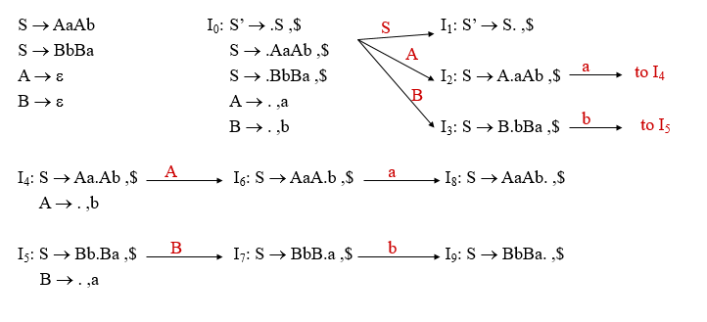
Canonical LR(1) Collection -- Example

Slide 36
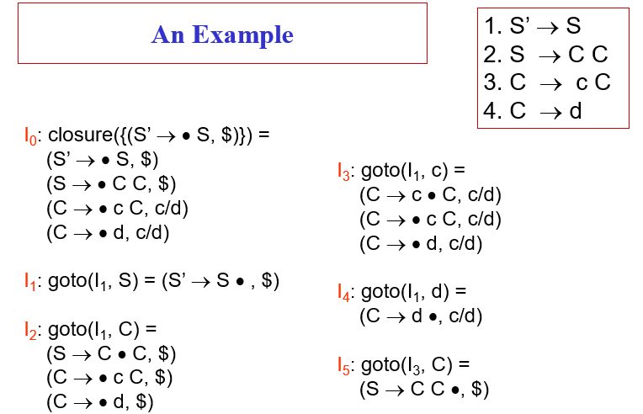

Slide 37
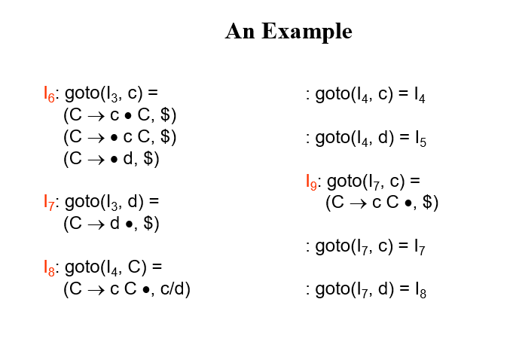

Slide 38
S’ → • S, $
S → • C C, $
C → • c C, c/d
C → • d, c/d
I₁
S
C
c
d
(S’ → S • , $
S → C • C, $
C → • c C, $
C → • d, $
I₅
C
c
d
S → C C •, $
I₂
c
I₆
C → c • C, $
C → • c C, $
C → • d, $
I₉
I₇
C → cC •, $
c
C → d •, $
C → c • C, c/d
C → • c C, c/d
C → • d, c/d
C
I₈
I₃
C → c C •, c/d
I₄
d
C → d •, c/d

Slide 39
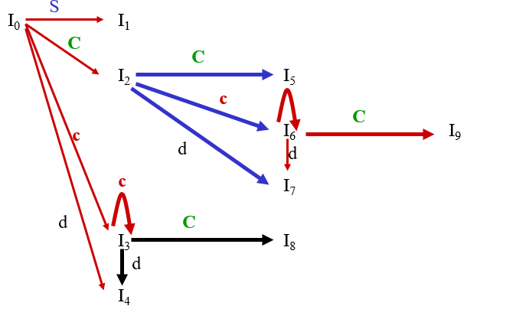
An Example

Slide 40
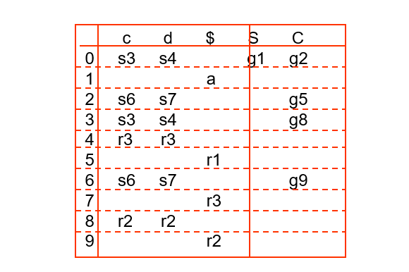
(CLR) Parsing Tables for the above Grammar

Slide 41
The Core of LR(1) Items
The core of a set of LR(1) Items is the set of their first components (i.e., LR(0) items)
The core of the set of LR(1) items { (C → c • C, c/d),
(C → • c C, c/d),
(C → • d, c/d) } is { C → c • C,
C → • c C,
C → • d }

Slide 42
Construction of LR(1) Parsing Tables
Construct the canonical collection of sets of LR(1) items for G’. C←{I₀,...,I_{n}}
Create the parsing action table as follows
If a is a terminal, A→α.aβ,b in I_{i} and goto(I_{i},a)=I_{j} then action[i,a] is shift j.
If A→α.,a is in I_{i} , then action[i,a] is reduce A→α where A≠S’.
If S’→S.,$ is in I_{i} , then action[i,$] is accept.
If any conflicting actions generated by these rules, the grammar is not LR(1).
Create the parsing goto table
for all non-terminals A, if goto(I_{i},A)=I_{j} then goto[i,A]=j
All entries not defined by (2) and (3) are errors.
Initial state of the parser contains S’→.S,$

Slide 43
LALR Parsing Tables
LALR stands for Lookahead LR.
LALR parsers are often used in practice because LALR parsing tables are smaller than LR(1) parsing tables.
The number of states in SLR and LALR parsing tables for a grammar G are equal.
But LALR parsers recognize more grammars than SLR parsers.
yacc creates a LALR parser for the given grammar.
A state of LALR parser will be again a set of LR(1) items.

Slide 44
Creating LALR Parsing Tables
Canonical LR(1) Parser ➔ LALR Parser
shrink # of states
This shrink process may introduce a reduce/reduce conflict in the resulting LALR parser (so the grammar is NOT LALR)
But, this shrik process does not produce a shift/reduce conflict.

Slide 45
The Core of A Set of LR(1) Items
The core of a set of LR(1) items is the set of its first component.
Ex: S → L.=R,$ ➔ S → L.=R Core
R → L.,$ R → L.
We will find the states (sets of LR(1) items) in a canonical LR(1) parser with same cores. Then we will merge them as a single state.
I₁:L → id.,= A new state: I₁₂: L → id.,=
➔ L → id.,$
I₂:L → id.,$ have same core, merge them
We will do this for all states of a canonical LR(1) parser to get the states of the LALR parser.
In fact, the number of the states of the LALR parser for a grammar will be equal to the number of states of the SLR parser for that grammar.

Slide 46
Creation of LALR Parsing Tables
Create the canonical LR(1) collection of the sets of LR(1) items for the given grammar.
For each core present; find all sets having that same core; replace those sets having same cores with a single set which is their union. C={I₀,...,I_{n}} ➔ C’={J₁,...,J_{m}} where m ≤ n
Create the parsing tables (action and goto tables) same as the construction of the parsing tables of LR(1) parser.
Note that: If J=I₁ ∪ ... ∪ I_{k} since I₁,...,I_{k} have same cores
➔ cores of goto(I₁,X),...,goto(I₂,X) must be same.
So, goto(J,X)=K where K is the union of all sets of items having same cores as goto(I₁,X).
If no conflict is introduced, the grammar is LALR(1) grammar. (We may only introduce reduce/reduce conflicts; we cannot introduce a shift/reduce conflict)

Slide 47
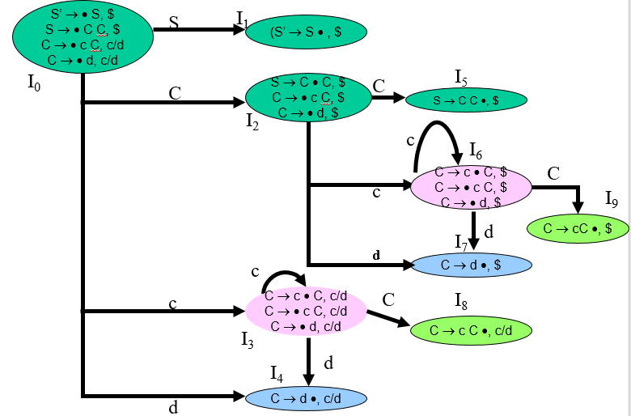

Slide 48
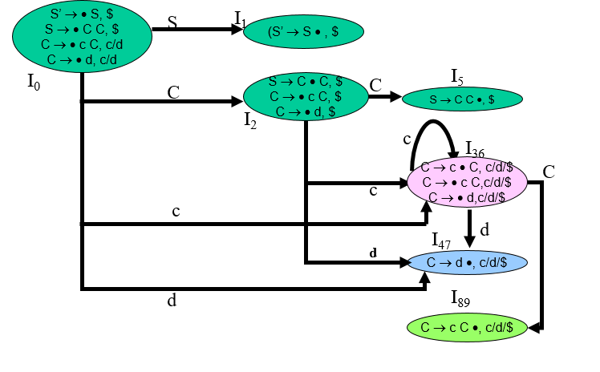

Slide 49
LALR Parse Table
c d $ S C
0 s36 s47 1 2
1 acc
2 s36 s47 5
36 s36 s47 89
47 r3 r3 r3
5 r1
89 r2 r2 r2

Slide 50
Shift/Reduce Conflict
We say that we cannot introduce a shift/reduce conflict during the shrink process for the creation of the states of a LALR parser.
Assume that we can introduce a shift/reduce conflict. In this case, a state of LALR parser must have:
A → α.,a and B → β.aγ,b
This means that a state of the canonical LR(1) parser must have:
A → α.,a and B → β.aγ,c
But, this state has also a shift/reduce conflict. i.e. The original canonical LR(1) parser has a conflict.
(Reason for this, the shift operation does not depend on lookaheads)

Slide 51
Reduce/Reduce Conflict
But, we may introduce a reduce/reduce conflict during the shrink process for the creation of the states of a LALR parser.
I₁ : A → α.,a I₂: A → α.,b
B → β.,b B → β.,c
⇓
I₁₂: A → α.,a/b ➔ reduce/reduce conflict
B → β.,b/c

Slide 52
Using Ambiguous Grammars
All grammars used in the construction of LR-parsing tables must be un-ambiguous.
Can we create LR-parsing tables for ambiguous grammars ?
Yes, but they will have conflicts.
We can resolve these conflicts in favor of one of them to disambiguate the grammar.
At the end, we will have again an unambiguous grammar.
Why we want to use an ambiguous grammar?
Some of the ambiguous grammars are much natural, and a corresponding unambiguous grammar can be very complex.
Usage of an ambiguous grammar may eliminate unnecessary reductions.
Ex.
E → E+T | T
E → E+E | E*E | (E) | id ➔ T → T*F | F
F → (E) | id

Slide 53
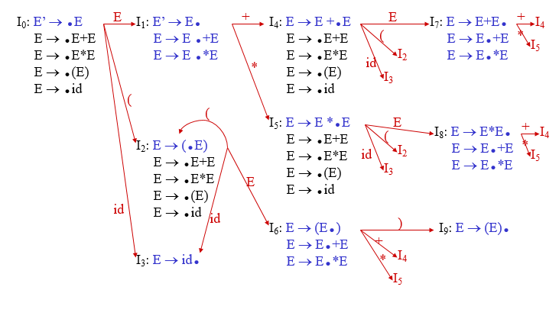
Sets of LR(0) Items for Ambiguous Grammar

Slide 54
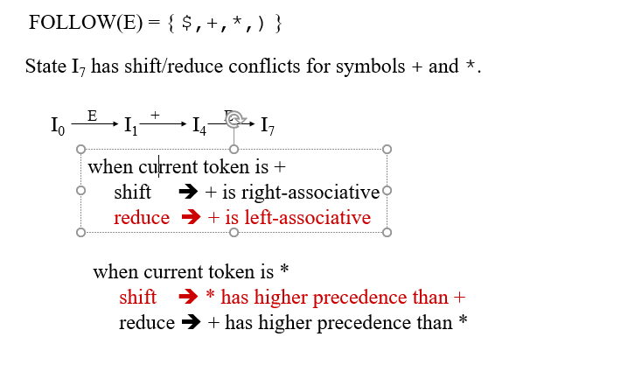
SLR-Parsing Tables for Ambiguous Grammar

Slide 55
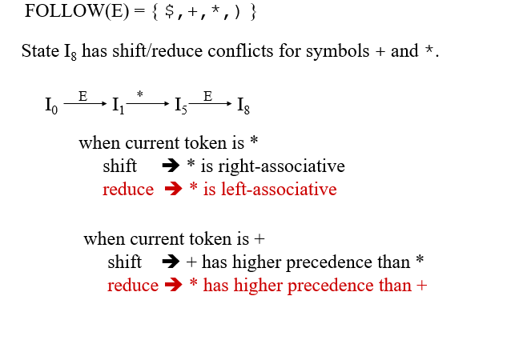
SLR-Parsing Tables for Ambiguous Grammar

Slide 56
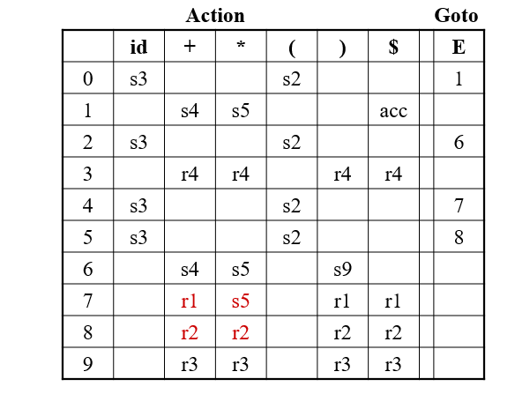
SLR-Parsing Tables for Ambiguous Grammar

Slide 57
Error Recovery in LR Parsing
An LR parser will detect an error when it consults the parsing action table and finds an error entry. All empty entries in the action table are error entries.
Errors are never detected by consulting the goto table.
An LR parser will announce error as soon as there is no valid continuation for the scanned portion of the input.
A canonical LR parser (LR(1) parser) will never make even a single reduction before announcing an error.
The SLR and LALR parsers may make several reductions before announcing an error.
But, all LR parsers (LR(1), LALR and SLR parsers) will never shift an erroneous input symbol onto the stack.

Slide 58
Panic Mode Error Recovery in LR Parsing
Scan down the stack until a state s with a goto on a particular nonterminal A is found. (Get rid of everything from the stack before this state s).
Discard zero or more input symbols until a symbol a is found that can legitimately follow A.
The symbol a is simply in FOLLOW(A), but this may not work for all situations.
The parser stacks the nonterminal A and the state goto[s,A], and it resumes the normal parsing.
This nonterminal A is normally is a basic programming block (there can be more than one choice for A).
stmt, expr, block, ...

Slide 59
Phrase Mode Error Recovery in LR Parsing
Each empty entry in the action table is marked with a specific error routine.
An error routine reflects the error that the user most likely will make in that case.
An error routine inserts the symbols into the stack or the input (or it deletes the symbols from the stack and the input, or it can do both insertion and deletion).
missing operand
unbalanced right parenthesis

Slide 60


